Slide 1
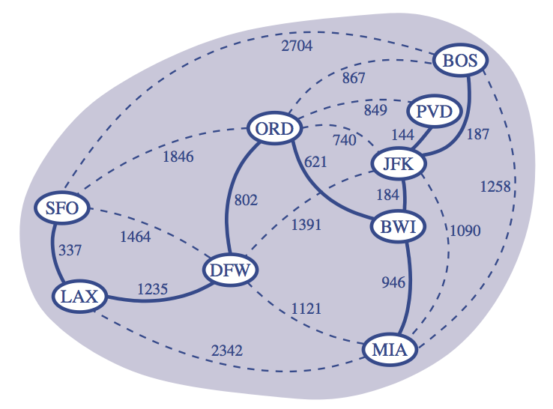
Minimum Spanning Trees
"One day Chao-Chou fell down in the snow, and called out: "Help me! Help Me!"
A monk came and lay down beside him.
Chao-Chou got up and went away."
- Zen Koan
CLRS, Sections 23.1 – 23.2

Slide 2
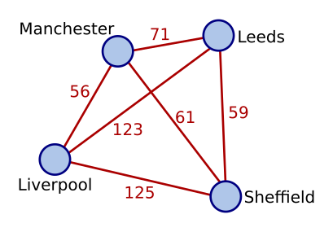
Weighted Graphs
A weighted graph G is G=<V,E>:
V is the set of nodes.
E is the set of edges (directed or undirected).
with the weight function w that assigns a weight to each edge (u,v) in E.
For example:
w(Leeds, Sheffield) = 59
and
w(Manchester, Liverpool) = 61

Slide 3
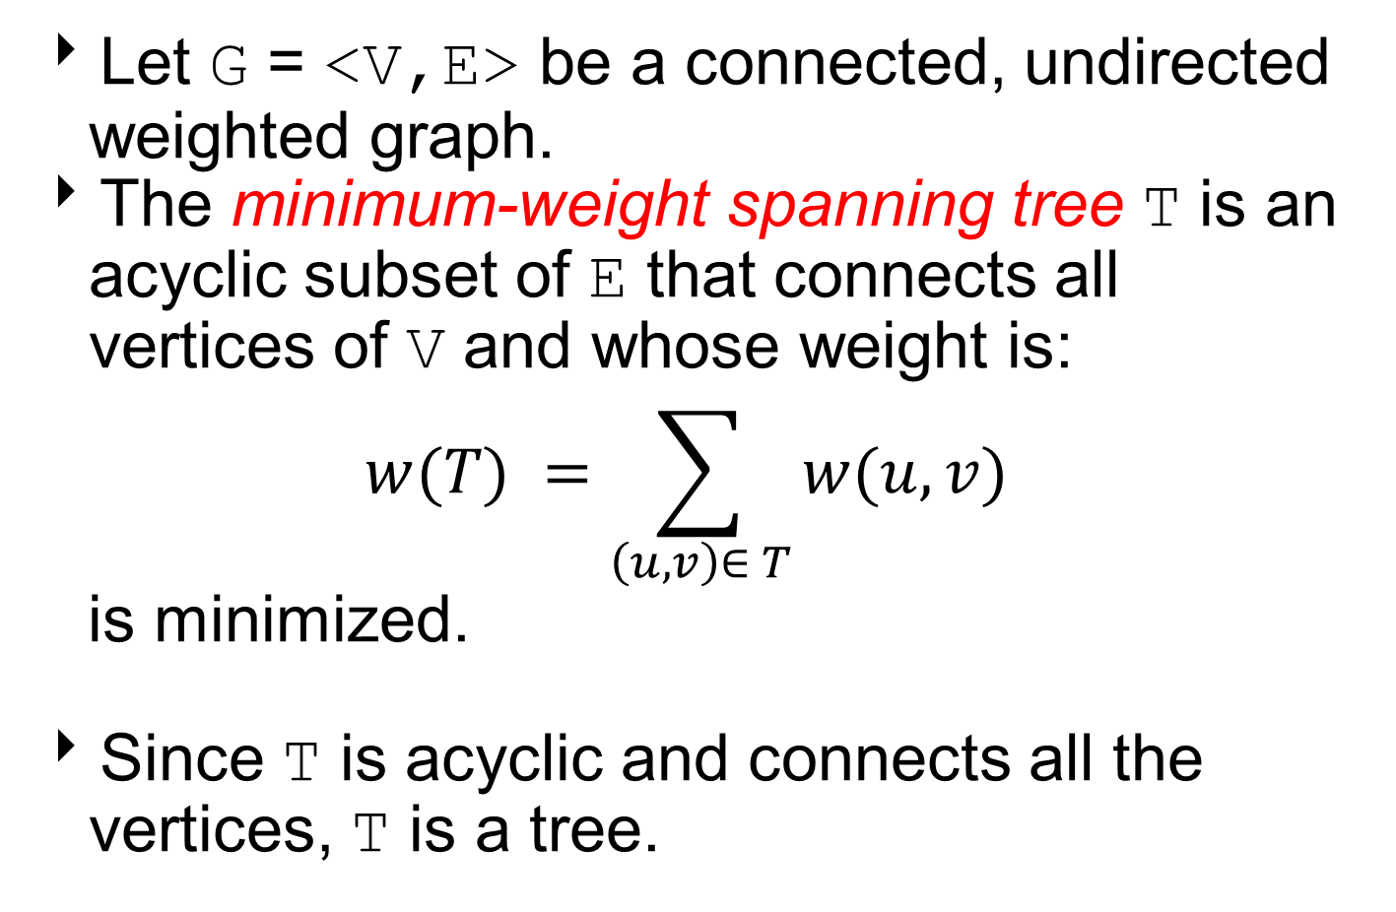
Minimum Spanning Tree (MST)
Let G = <V,E> be a connected, undirected weighted graph.
The minimum-weight spanning tree T is an acyclic subset of E that connects all vertices of V and whose weight is:
$$w(T) =\sum_{\left(u,v\right)∈ T}{w(u,v)}$$
is minimized.
Since T is acyclic and connects all the vertices, T is a tree.

Slide 4
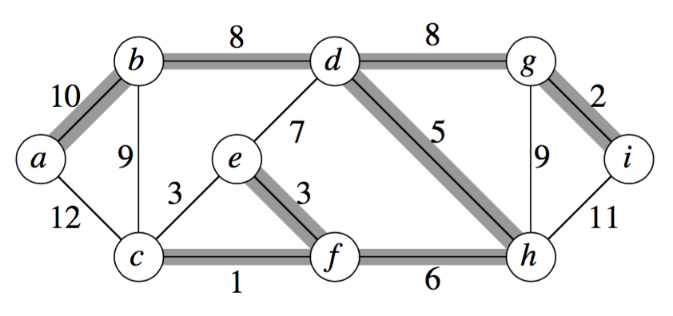
Example: MST
In this graph, the shaded edges represent a MST T with weight w(T)=43.

Slide 5
Example: MST
The MST is not unique.
If we replace the edge (e,f) with the edge (e,c), we obtain another MST T’ with the same weight w(T’)=43.

Slide 6
MST Algorithms
Kruskal’s Algorithm
Prim’s Algorithm

Slide 7
Kruskal’s Algorithm
Partition vertices into clusters.
Initially, single-vertex clusters.
Sort edges according to weight.
Merge “closest” clusters.
When merge clusters, add edge to, A, a set of edges that will be included in an MST.
At the end of the algorithm:
All vertices merged into a single cluster.
The edges in the set A represent an MST.

Slide 8
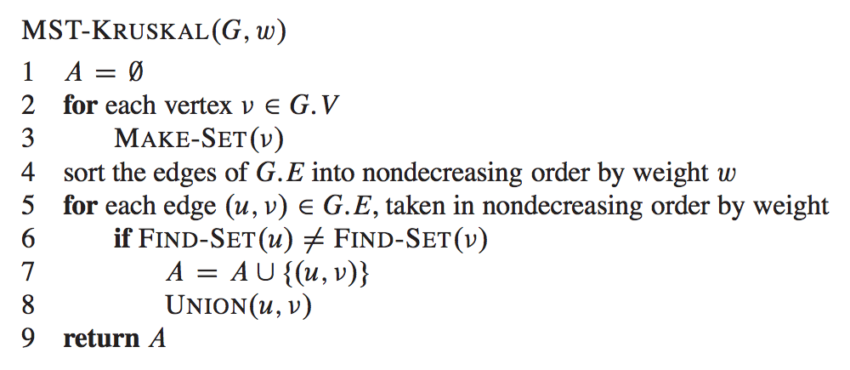
Kruskal’s Algorithm
Input:
G=<V,E>, an undirected graph.
w, edge weight function.
Find-Set(u) returns cluster of vertices containing u.
UNION(u,v) combines clusters containing u and v.

Slide 9
Example: Kruskal’s Algorithm
8
B
9
E
1
5
C
11
3
7
D
A
10
E_{sorted}={(A,B),(D,E),(B,C),(A,C),(B,E),(C,E),(A,D),(C,D)}
A={}
Clusters ={{A},{B},{C},{D},{E}}

Slide 10
Example: Kruskal’s Algorithm
8
B
remove (A,B)
Find-Set(A) ≠ Find-Set(B)
add (A,B) to A
Union(Find-Set(A), Find-Set(B))
E
9
1
5
C
11
3
7
D
A
10
E_{sorted}={(D,E),(B,C),(A,C),(B,E),(C,E),(A,D),(C,D)}
A={(A,B)}
Clusters ={{A,B},{C},{D},{E}}

Slide 11
Example: Kruskal’s Algorithm
8
B
remove (D,E)
Find-Set(D) ≠ Find-Set(E)
add (D,E) to A
Union(Find-Set(D), Find-Set(E))
E
9
1
5
C
11
3
7
D
A
10
E_{sorted}={(B,C),(A,C),(B,E),(C,E),(A,D),(C,D)}
A={(A,B),(D,E)}
Clusters ={{A,B},{C},{D,E}}

Slide 12
Example: Kruskal’s Algorithm
8
B
remove (B,C)
Find-Set(B) ≠ Find-Set(C)
add (B,C) to A
Union(Find-Set(B), Find-Set(C))
E
9
1
5
C
11
3
7
D
A
10
E_{sorted}={(A,C),(B,E),(C,E),(A,D),(C,D)}
A={(A,B),(D,E),(B,C)}
Clusters ={{A,B,C},{D,E}}

Slide 13
Example: Kruskal’s Algorithm
8
B
remove (A,C)
Find-Set(A) = Find-Set(C)
don’t add (A,C) to A
E
9
1
5
C
11
3
7
D
A
10
E_{sorted}={(B,E),(C,E),(A,D),(C,D)}
A={(A,B),(D,E),(B,C)}
Clusters ={{A,B,C},{D,E}}

Slide 14
Example: Kruskal’s Algorithm
8
B
remove (B,E)
Find-Set(B) ≠ Find-Set(E)
add (B,E) to A
Union(Find-Set(B), Find-Set(E))
E
9
1
5
C
11
3
7
D
A
10
E_{sorted}={(C,E),(A,D),(C,D)}
A={(A,B),(D,E),(B,C),(B,E)}
Clusters ={{A,B,C,D,E}}

Slide 15
Example: Kruskal’s Algorithm
8
B
remove (C,E)
Find-Set(C) = Find-Set(E)
don’t add (C,E) to A
E
9
1
5
C
11
3
7
D
A
10
E_{sorted}={(A,D),(C,D)}
A={(A,B),(D,E),(B,C),(B,E)}
Clusters ={{A,B,C,D,E}}

Slide 16
Example: Kruskal’s Algorithm
8
B
remove (A,D)
Find-Set(A) = Find-Set(D)
don’t add (A,D) to A
E
9
1
5
C
11
3
7
D
A
10
E_{sorted}={(C,D)}
A={(A,B),(D,E),(B,C),(B,E)}
Clusters ={{A,B,C,D,E}}

Slide 17
Example: Kruskal’s Algorithm
8
B
remove (C,D)
Find-Set(C) = Find-Set(D)
don’t add (C,D) to A
E
9
1
5
C
11
3
7
D
A
10
E_{sorted}={}
A={(A,B),(D,E),(B,C),(B,E)}
Clusters ={{A,B,C,D,E}}

Slide 18
Example: Kruskal’s Algorithm
8
B
9
E
5
1
C
3
11
7
D
A
10
MST
A={(A,B),(D,E),(B,C),(B,E)}
Clusters ={{A,B,C,D,E}}

Slide 19
Kruskal’s Algorithm
If implemented using the disjoint-set data structure
Make-Set costs O(1)
Find-Set costs O(log|V|)
Union costs O(1)
O(|V|)
O(|E|log(|E|))
O(|E|log(|V|))
The cost of Kruskal’s algorithm is
O(|E|log(|E|)) + O(|E|log(|V|)) = O(|E|log(|V|))

Slide 20
Prim’s Algorithm
Given a start vertex r, that represents the root of the MST, grow the MST one vertex at a time.
Store with each vertex v a key value representing the smallest weight of an edge connecting v to a vertex in the partial tree representing an MST.
At each step:
Add vertex u not in tree with the smallest key value.
Update keys of the vertices adjacent to u.

Slide 21
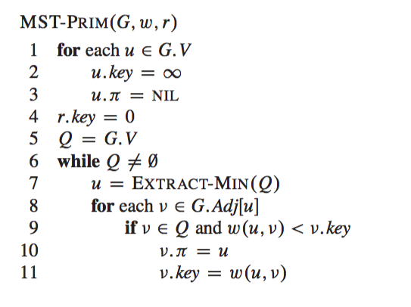
Prim’s Algorithm
Input:
G =<V,E>,an undirected graph.
w, an edge weight function.
r, the root vertex.
Q is a min-priority queue

Slide 22
Example: Prim’s Algorithm
∞
∞
7
D
B
4
∞
9
∞
2
5
F
C
8
8
3
E
A
7
∞
0
Vertex | A | B | C | D | E | F
Key | 0 | ∞ | ∞ | ∞ | ∞ | ∞
π | - | - | - | - | - | -
Q: A B C D E F

Slide 23

Example: Prim’s Algorithm
∞
2
7
D
B
4
8
9
∞
u $←$A
2
5
F
C
8
8
3
E
A
7
7
0
Vertex | A | B | C | D | E | F
Key | 0 | 2 | 8 | ∞ | 7 | ∞
π | - | A | A | - | A | -
Q: B E C D F

Slide 24

Example: Prim’s Algorithm
7
2
7
D
B
4
5
9
∞
u $←$B
2
5
F
C
8
8
3
E
A
7
7
0
Vertex | A | B | C | D | E | F
Key | 0 | 2 | 5 | 7 | 7 | ∞
π | - | A | B | B | A | -
Q: D E C F

Slide 25

Example: Prim’s Algorithm
7
2
7
D
B
4
5
9
4
u $←$D
2
5
F
C
8
8
3
E
A
7
7
0
Vertex | A | B | C | D | E | F
Key | 0 | 2 | 5 | 7 | 7 | 4
π | - | A | B | B | A | D
Q: F E C

Slide 26

Example: Prim’s Algorithm
7
2
7
D
B
4
5
9
4
u $←$F
2
5
F
C
8
8
3
E
A
7
3
0
Vertex | A | B | C | D | E | F
Key | 0 | 2 | 5 | 7 | 3 | 4
π | - | A | B | B | F | E
Q: E C

Slide 27

Example: Prim’s Algorithm
7
2
7
D
B
4
5
9
4
u $←$E
2
5
F
C
8
8
3
E
A
7
3
0
Vertex | A | B | C | D | E | F
Key | 0 | 2 | 5 | 7 | 3 | 4
π | - | A | B | B | F | E
Q: C

Slide 28

Example: Prim’s Algorithm
7
2
7
D
B
4
8
9
4
u $←$C
2
5
F
C
8
8
3
E
A
7
3
0
Vertex | A | B | C | D | E | F
Key | 0 | 2 | 8 | 7 | 3 | 4
π | - | A | A | B | F | E
Q:

Slide 29
Example: Prim’s Algorithm
7
2
7
D
B
4
5
9
4
2
5
F
C
8
8
3
E
A
7
3
0
MST
Vertex | A | B | C | D | E | F
Key | 0 | 2 | 5 | 7 | 3 | 4
π | - | A | B | B | F | E

Slide 30
Prim’s Algorithm Complexity
Within the while loop, execute |V| EXTRACT-MIN for cost of O(log(|V|))
and
update v.key for cost of O(log(|V|))at most |E| times
O(|V|)
O(1)
O(|V|)
O(|V|)log(|V|)
O(|E|)log(|V|)
The cost of Prim’s algorithm is
The total cost of the while is
O(|V|log(|V|)) + O(|E|log(|V|)) =
= O(|E|log(|V|))

Slide 31
Greedy Algorithms
The Kruskal’s and Prim’s algorithms are greedy algorithms.
A greedy algorithm always makes the choice that looks best at the moment.
It makes a locally optimal choice in the hope that this choice will lead to a globally optimal solution.
Greedy algorithms do not always yield optimal solutions, but for many problems they do.
For the MST problem, Kruskal’s and Prim’s algorithm produce optimal results.

Slide 33
Generic Algorithm
The generic algorithm manages a set of edges A that is always a subset of some minimum spanning tree.
Initially A = {}. At each step we add a safe edge (u,v) to A.
An edge (u,v) is safe to A if A U {(u,v)} is still a subset of a minimum spanning tree.

Slide 34
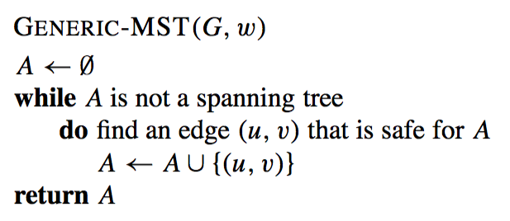
Generic Algorithm
INPUT
G = (V,E) is an undirected graph
w is the edge weighting function

Slide 35
Generic Algorithm
What kind of edges are safe to A?
Let us introduce some definitions.
A cut (S, V−S) is a partition of vertices into disjoint sets V and V−S.
An edge (u,v) in E crosses the cut (S, V−S) if one endpoint is in S and the other is in V−S.
A cut respects A if and only if no edge in A crosses the cut.
An edge is a light edge crossing a cut if and only if its weight is the minimum over all edges crossing the cut.
For a given cut there may be multiple light edges crossing it.

Slide 36
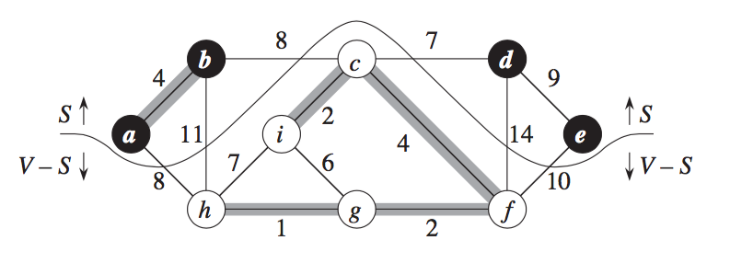
Generic Algorithm
Example
Let S be the set of black nodes. Then (S,V−S) is a cut.
A subset A of edges is shaded. A is a subset of some MST.
An edge crosses the cut if it is between a black node and a white one. E.g. the edge (b,h) crosses the cut.
The cut (S,V−S) respects the set A as A does not contain any edge crossing the cut.
The edge (c,d) is a light edge crossing the cut.

Slide 37
Generic Algorithm
What kind of edges are safe to A?
Theorem: Let A be a subset of some MST, (S, V−S) be a cut that respects A, and (u,v) be a light edge crossing (S, V−S). Then (u,v) is safe for A.
In our example, the edge (c,d) is a safe edge to add to A.

Slide 38
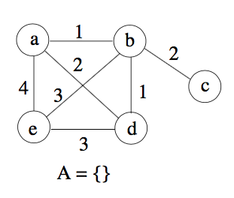
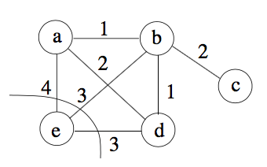
Generic Algorithm: Example
Humans can easily recognize a cut that respects A
If we choose the cut (S,V−S) where S = {e}, then a safe edge to add to A is either (e,b) or (e,d)
Suppose that we have this graph. A initially is empty.

Slide 39
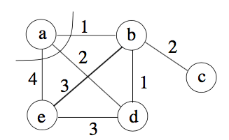
Generic Algorithm: Example
Humans can easily recognize a cut that respects A
A = {(e,b)}
A cut (S,V−S) that respects A is, for instance, S = {a} and V-S = {b,c,d,e}, then a safe edge to add to A is (a,b).

Slide 40
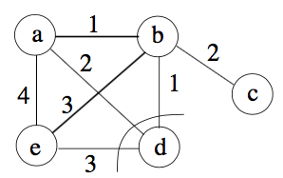
Generic Algorithm: Example
Humans can easily recognize a cut that respects A
A = {(e,b), (a,b)}
A cut (S,V−S) that respects A is, for instance, S = {d} and V-S = {a,b,c,e}, then a safe edge to add to A is (b,d).

Slide 41
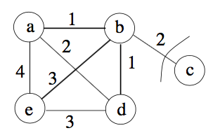
Generic Algorithm: Example
Humans can easily recognize a cut that respects A
A = {(e,b), (a,b), (b,d)}
A cut (S,V−S) that respects A is now S = {c} and V-S = {a,b,d,e}, then a safe edge to add to A is (b,c).

Slide 42
Generic Algorithm: Example
Minimum Spanning Tree
A = {(e,b), (a,b), (b,d), (b,c)}
MST weight is 7

Slide 43
Generic Algorithm
The algorithms of Kruskal and Prim each use a specific rule to determine a safe edge to add to A in the GENERIC-MST algorithm.

